Slide 1


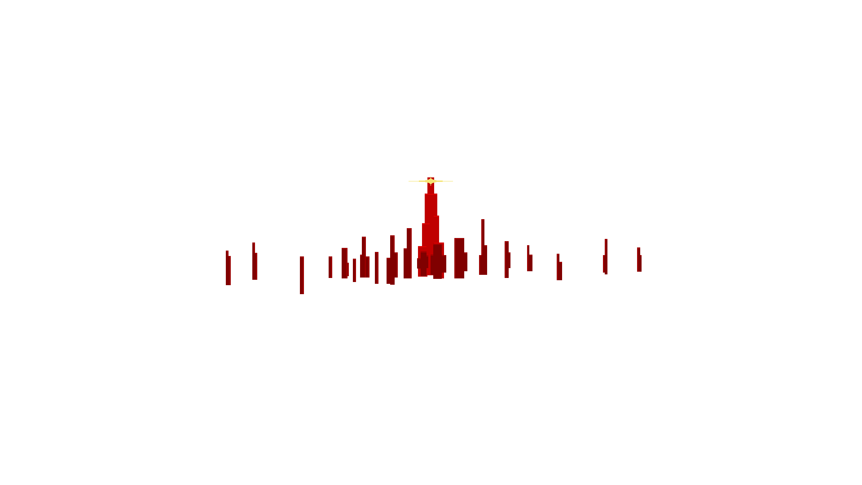
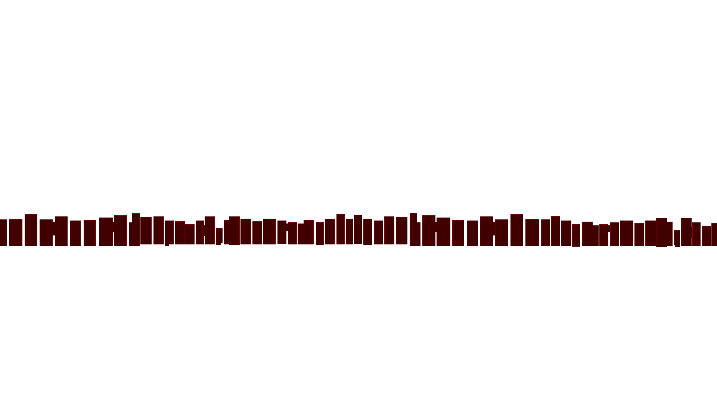

CYBERNUKE
CSCI352 PROJECT
BY KENNETH W. + VANCE B.

Slide 2
Background
What is CYBERNUKE?
CYBERNUKE is a post-apocalyptic cyberpunk roguelite game written in C# WPF.
Why did we do this project?
We thought making games would be fun :(
What do you need to know about this project?
Games in WPF are hard!

Slide 3
Approach
How did we do it?
We started with MVVM implementation (Observer variant)
Added each view starting with the Main Menu
Added the Combat Menu
Added the Overworld and Town Menus
Added the Pause Menu using a Decorator to put it onto the Overworld Menu

Slide 4
Approach
Special libraries/drivers?
We considered external libraries for audio implementation but scrapped the idea.
Design Patterns used:
MVVM (Observer variant): View & Menu switching
Decorator: Pause Menu implementation over the Overworld view

Slide 5
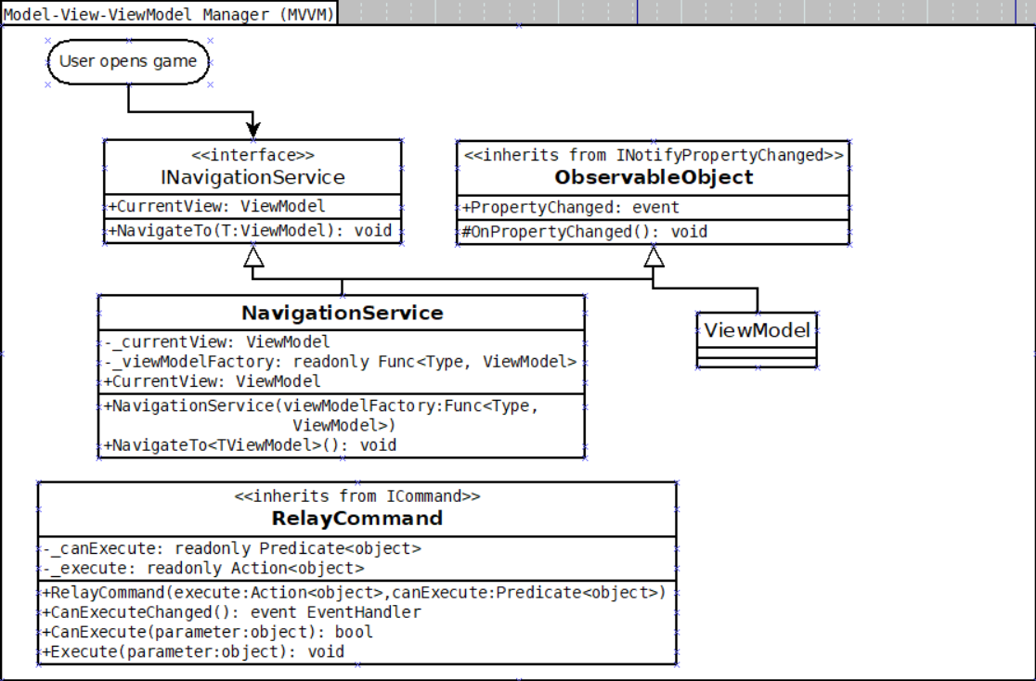
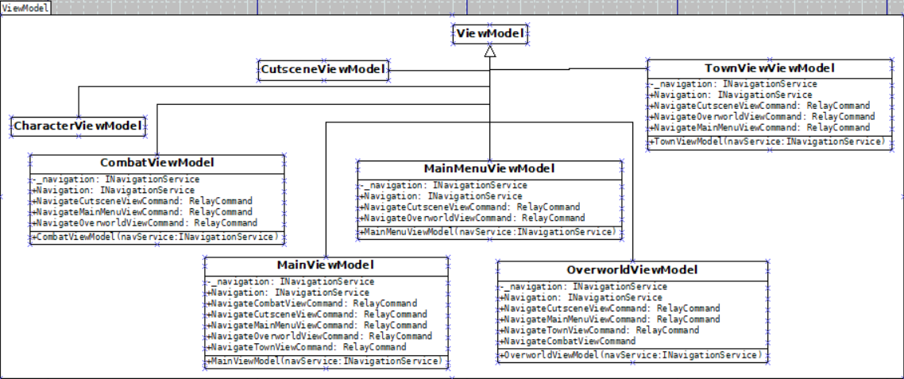
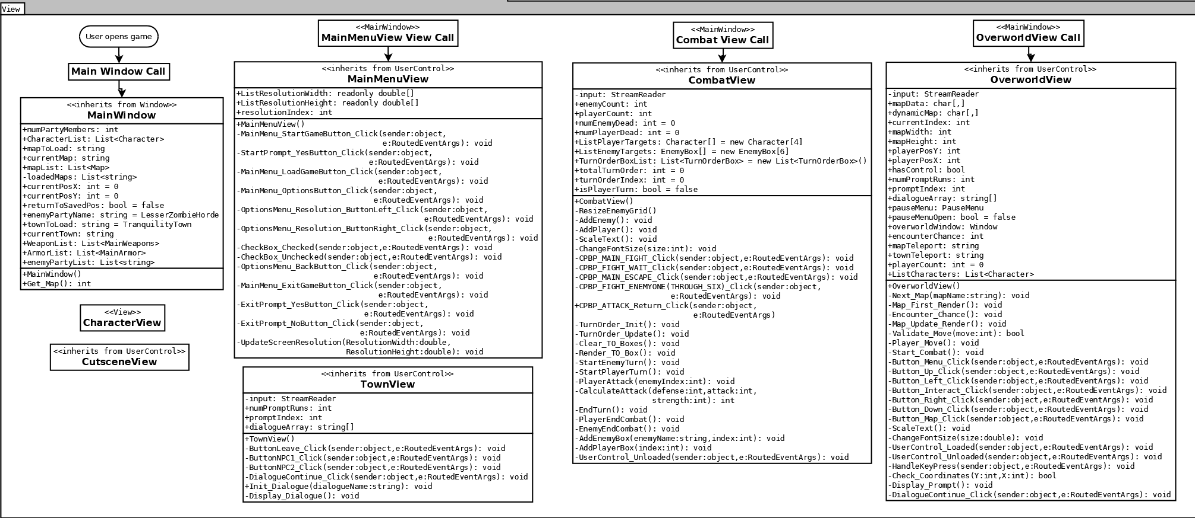
(UML with MVVM Pattern)

Slide 6
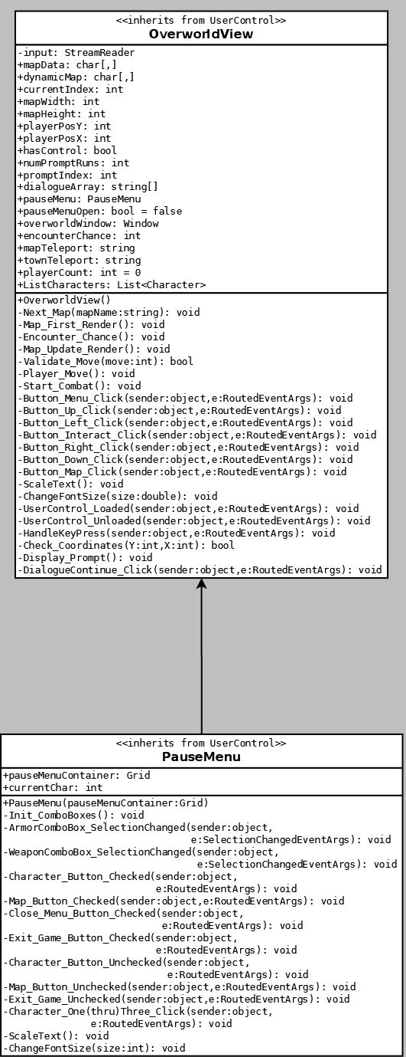
Decorator Pattern

Slide 7
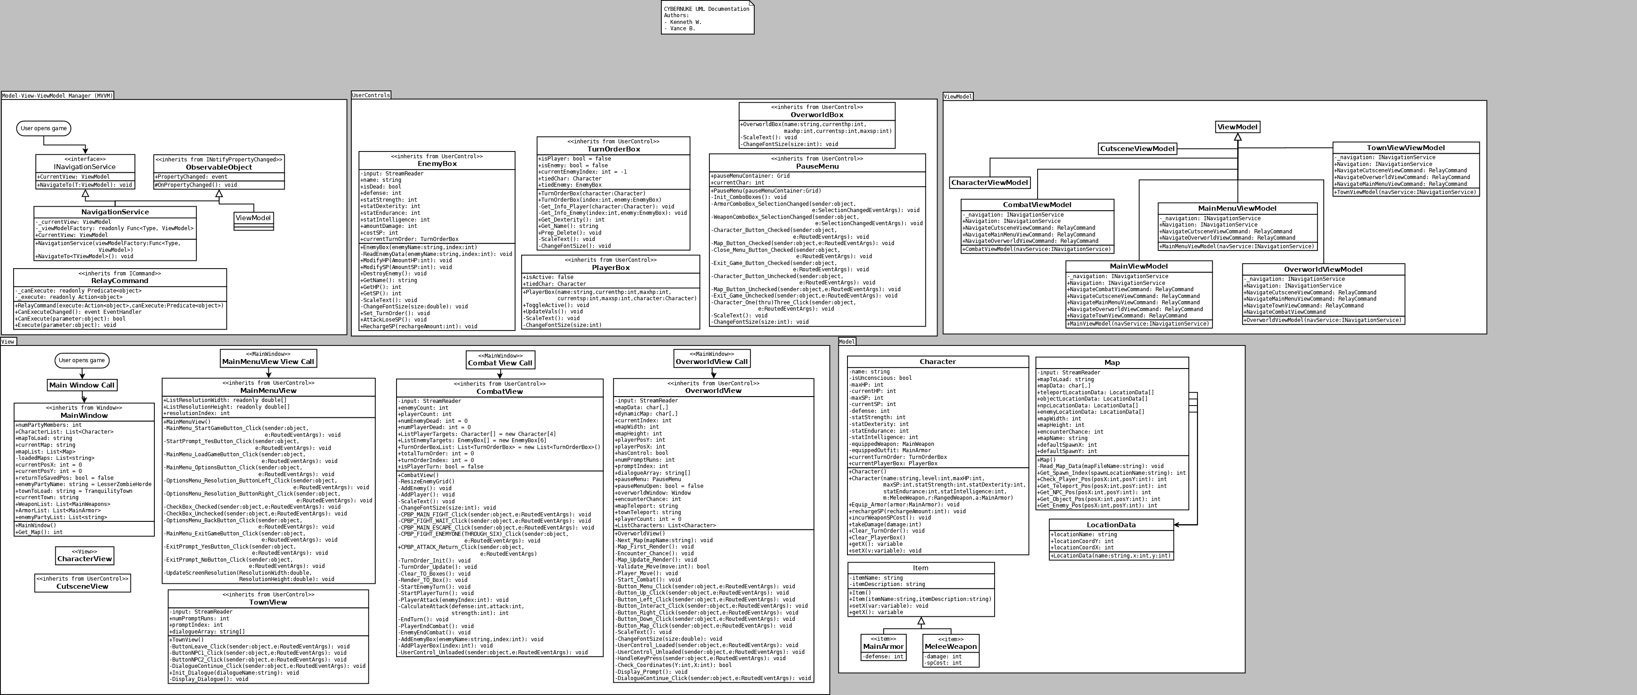
Our beautiful UML

Slide 8
Demo
Current features:
Main Menu: Start Demo, Options, Exit Game
Overworld Menu: Movement, Pause Menu, Map Interaction
Pause Menu: View Characters, Equip Items
Combat Menu: Fight, Wait, Escape
Town Menu: Talk to NPCs or Leave

Slide 9
Future Work
Where are you going to go next?
Music and Sound effects
Animations and Smoother Transitions
UI Polishing
Leveling System
Resistances
Actual Story

Slide 10
Questions
Our Repo:
https://github.com/JheKWall/CYBERNUKE
Vance B:
vanabren@ut.utm.edu
Kenneth W:
jhekwall@ut.utm.edu

